Slide 1
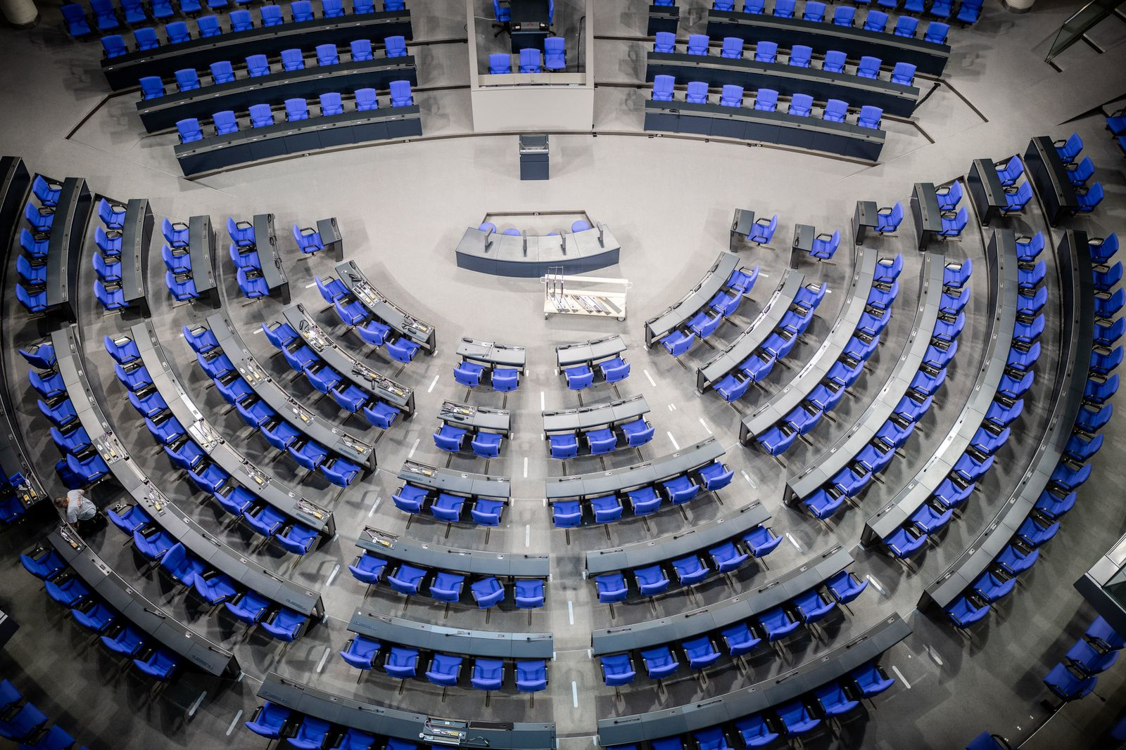
Who claps the most?
(D)IY – Data Integration Project

Slide 2
Name duplicates
If deputies have similar names, this might be hard for the algorithms to interprete correctly.
Cleaning step: Search for possible name similarities, then treat them manually
Result:
88 dagerous name similarities found
(only) 2 similarities in deputies of the 19th Bundestag:
Michael Grosse-Brömer and Michael Groß
Martina Renner and Martin Renner
Manual correction: Remove unnecessary deputy-event links:
If Michael Grosse-Blömer and Michael Groß both appear on an event, it is more likely that Michael Grosse-Blömer was the mentioned deputy

Slide 3
Deputies with changing attributes
Deputies change their party during a parliament period
Some deputies quit or start their parliament job during a parliament period
Everything represented in the original data, but not in the integrated data (because of the complexity)
No guarantee for correctness!!

Slide 4
Who claps the most?

Slide 5
Who claps the most alone?

Slide 6
Who claps for other parties?

Slide 7
Who laughs the most?

Slide 8
Who laughs the most alone?

Slide 9
Who disturbs the most?

Slide 10
Which is the most active party?

